Slide 1
Irrigation Machine Learning
Adrien Chabert

Slide 2

Motivation
To predict water quantity necessary for a specific plant for it to remain in its confort zone

Slide 3


200’000 km³ of fresh water
Notes:
200’000 km3 of fresh water on earth
2/3 for irrigation
Decrease water consumption of 20%-25%

Slide 4
Research of Literature
Collect Data
Integration of Machine Learning Algorithm
Test our result
Create a watering plan

Slide 5
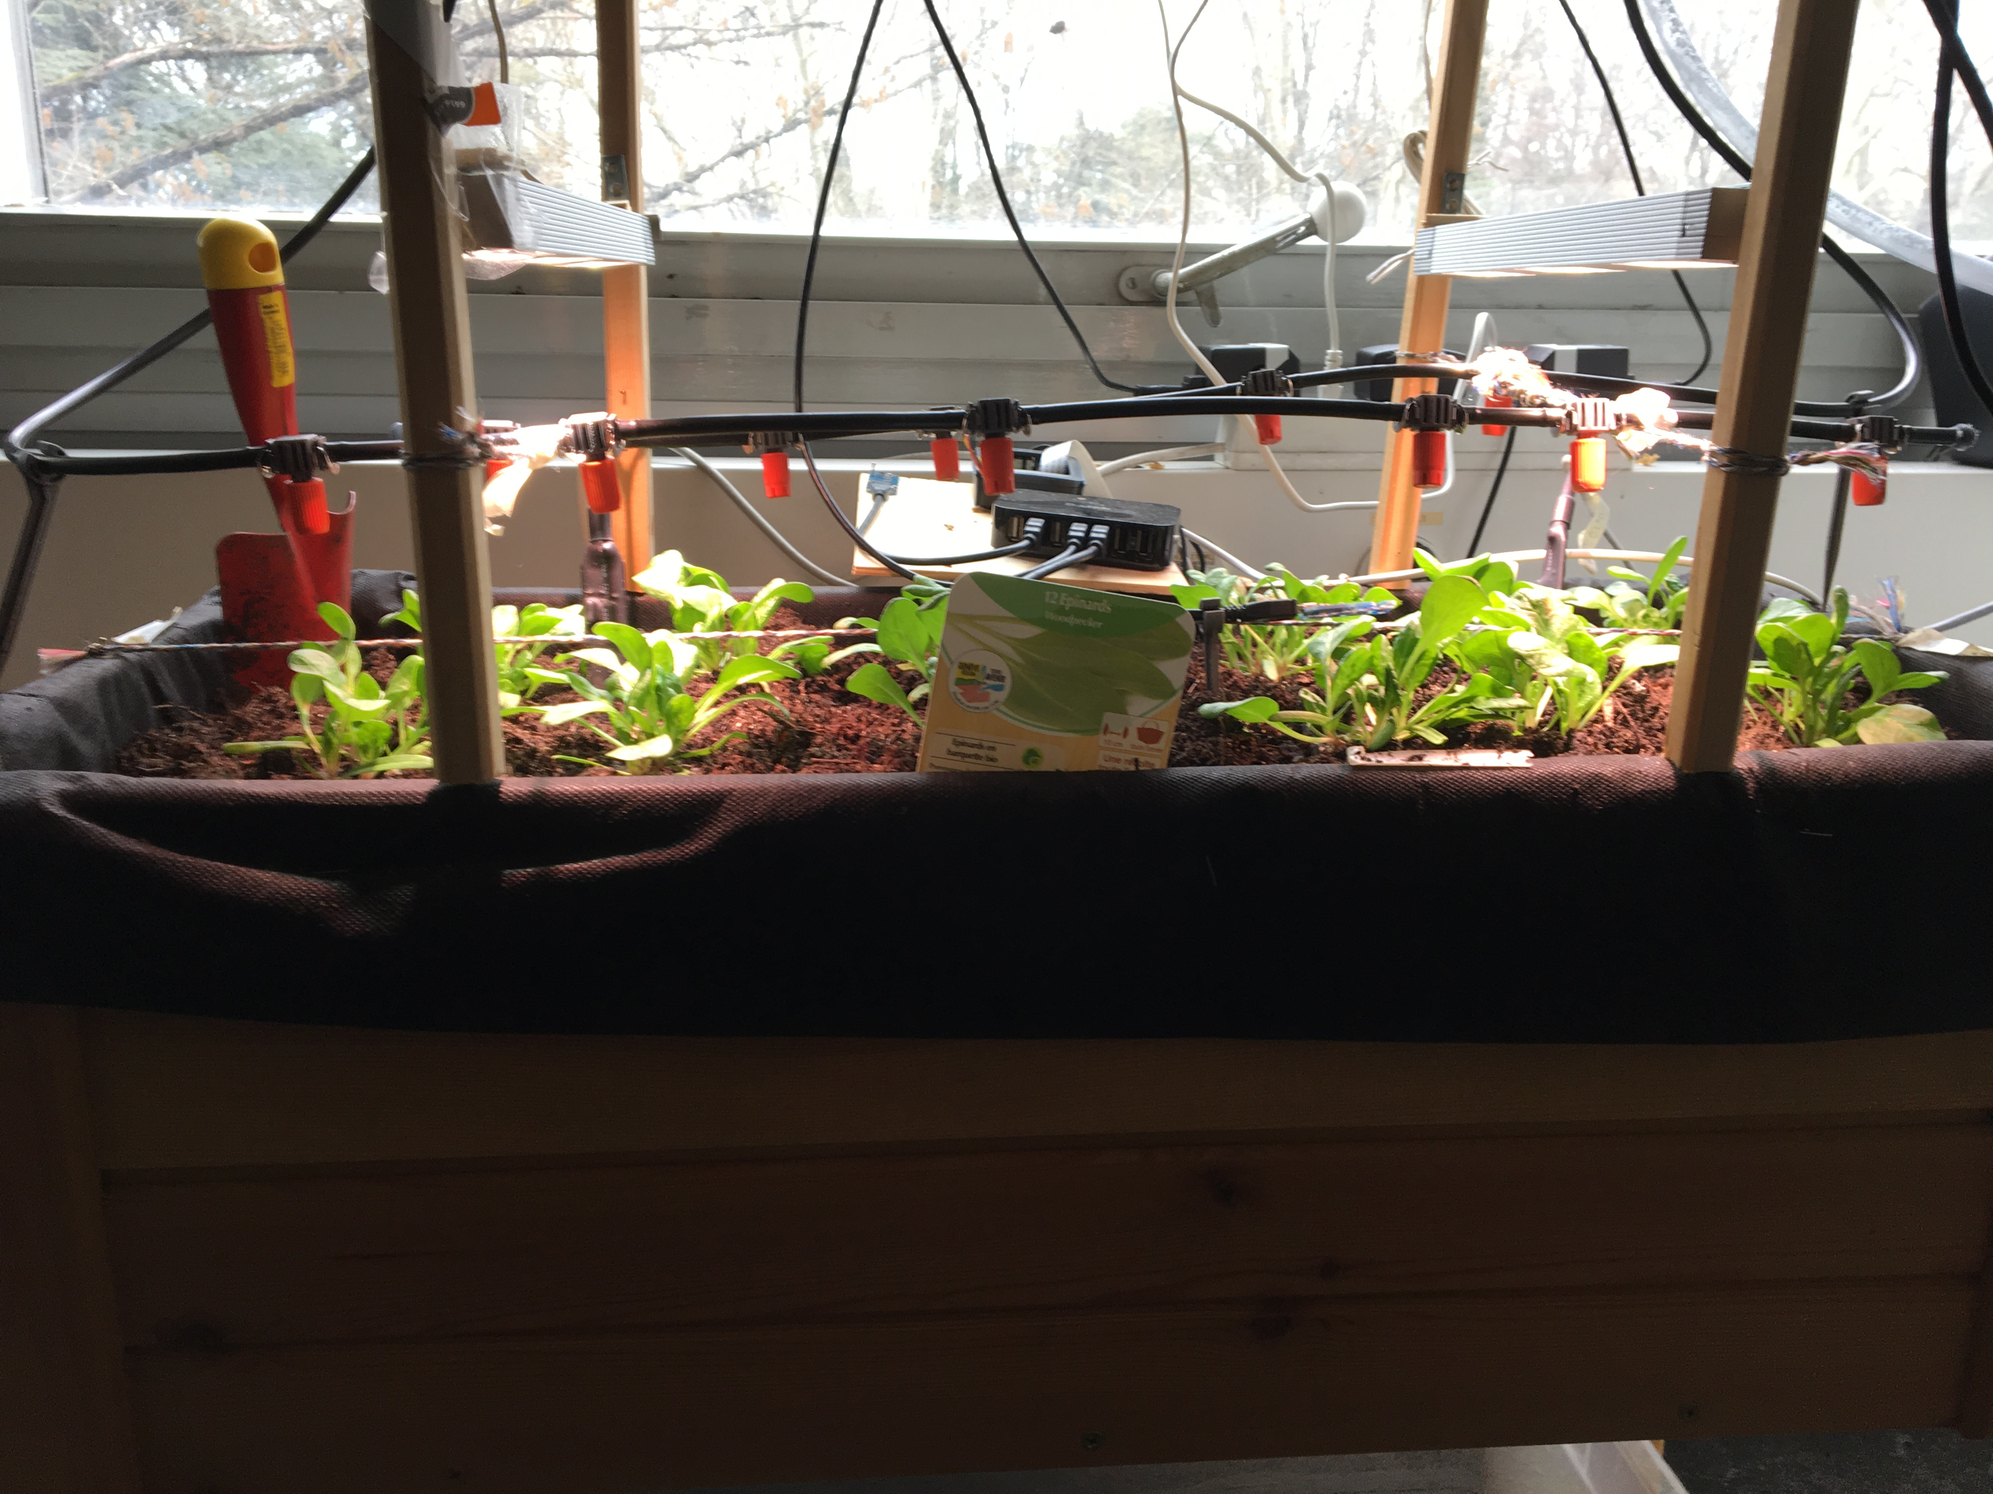
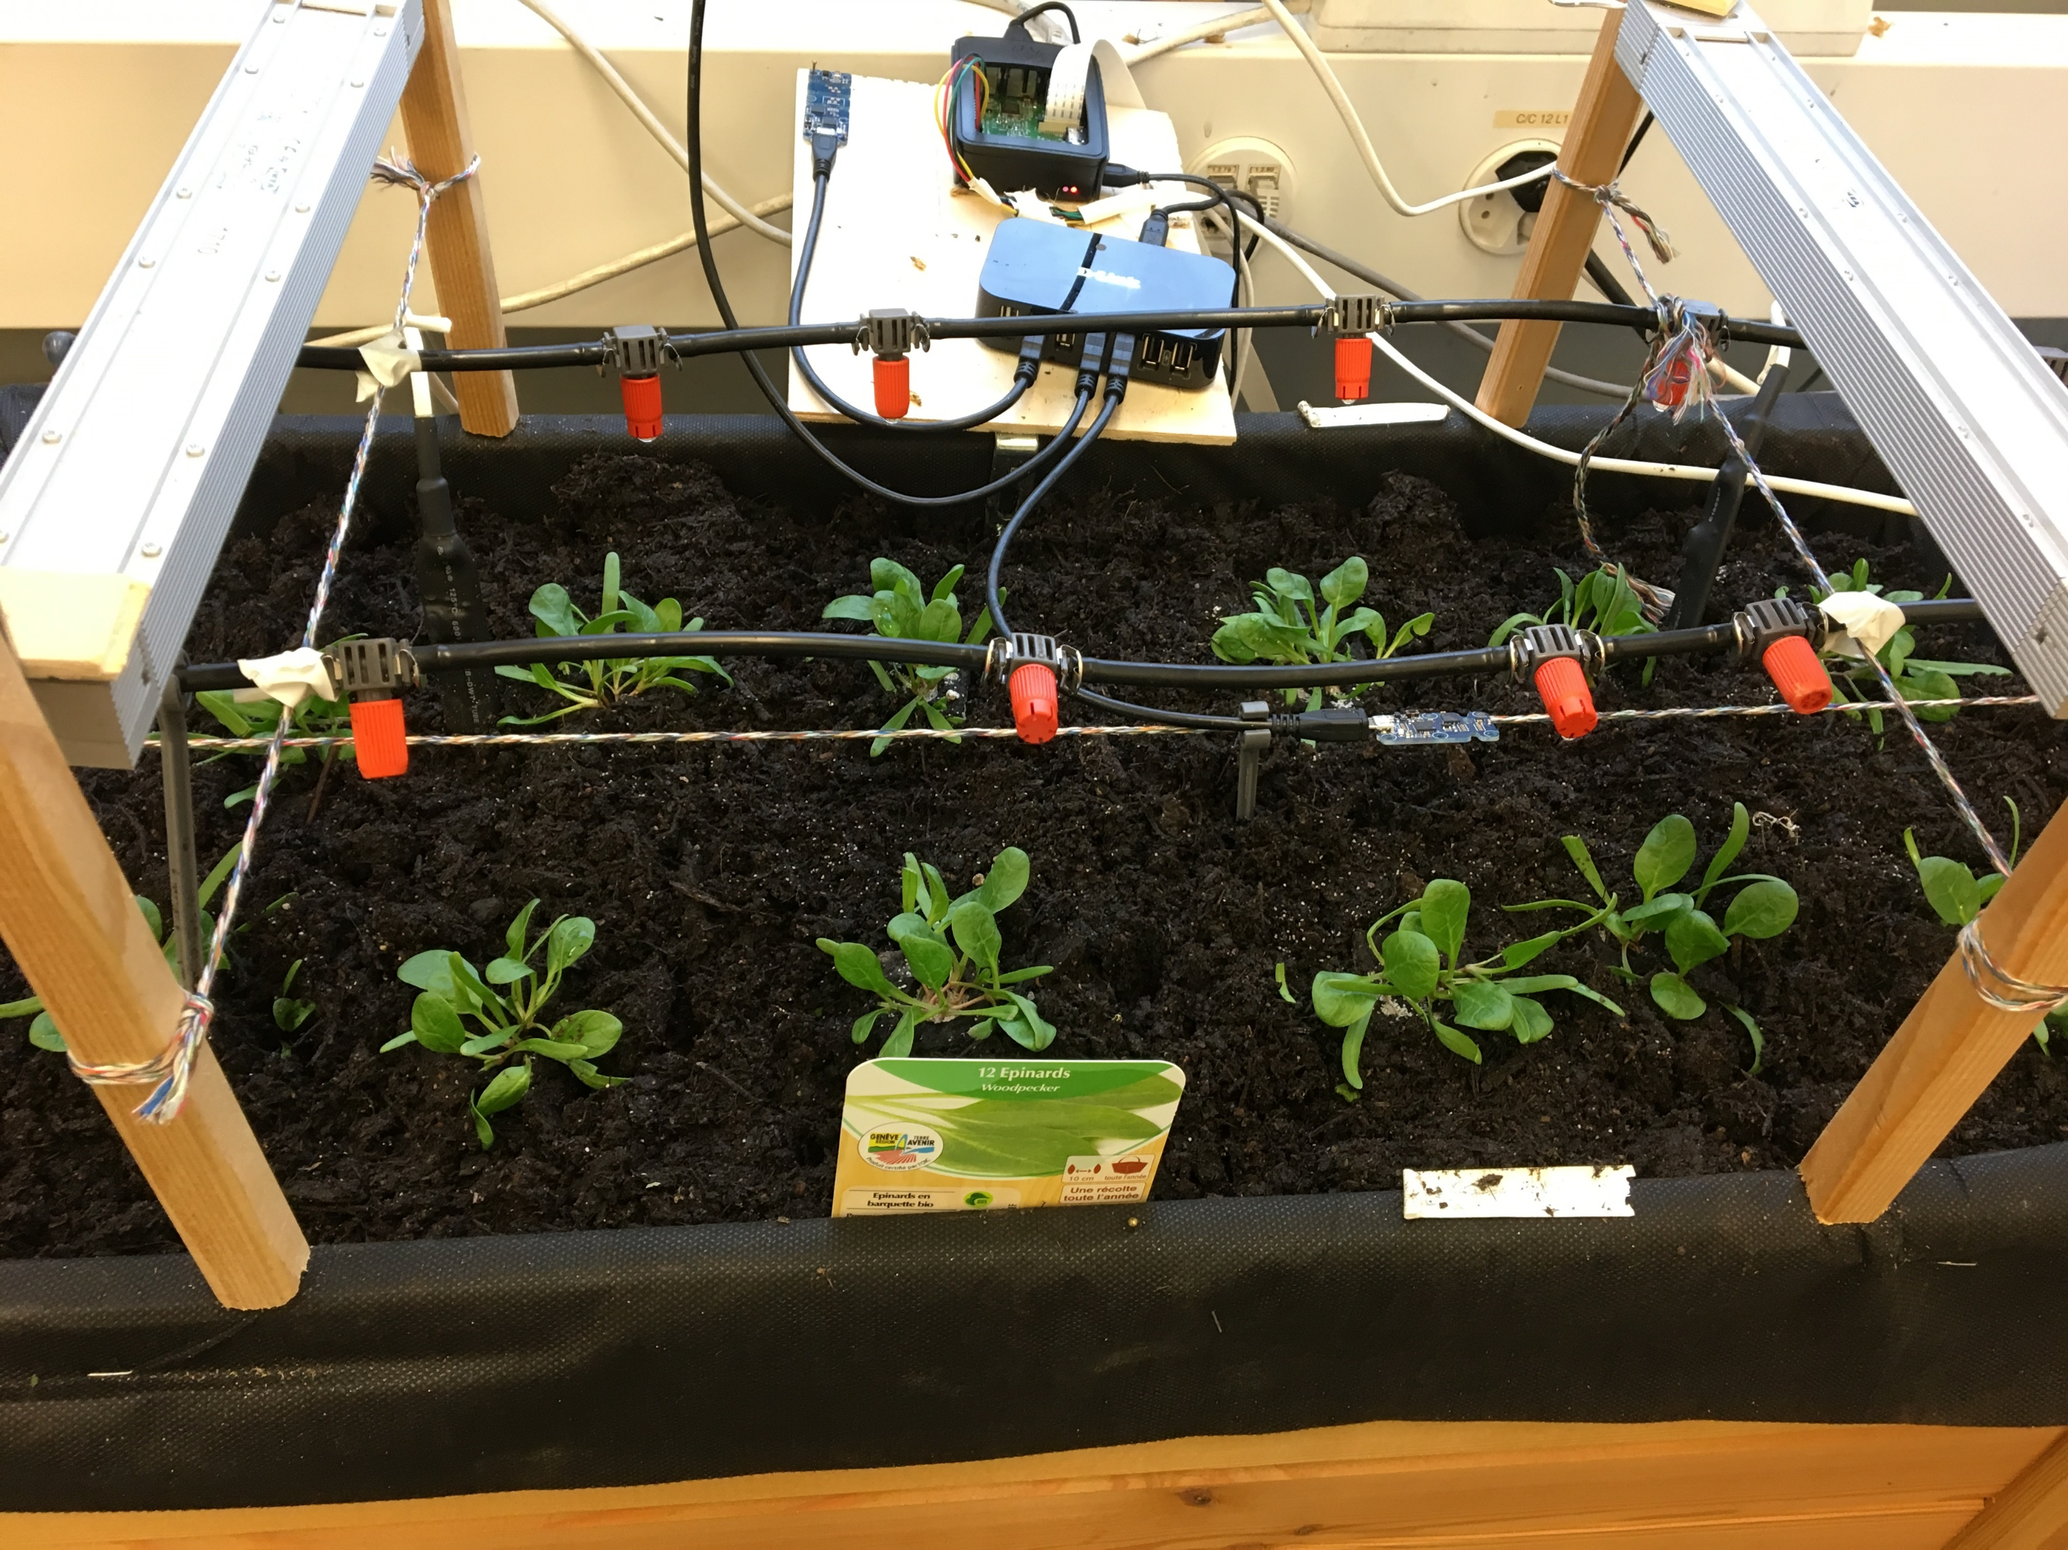
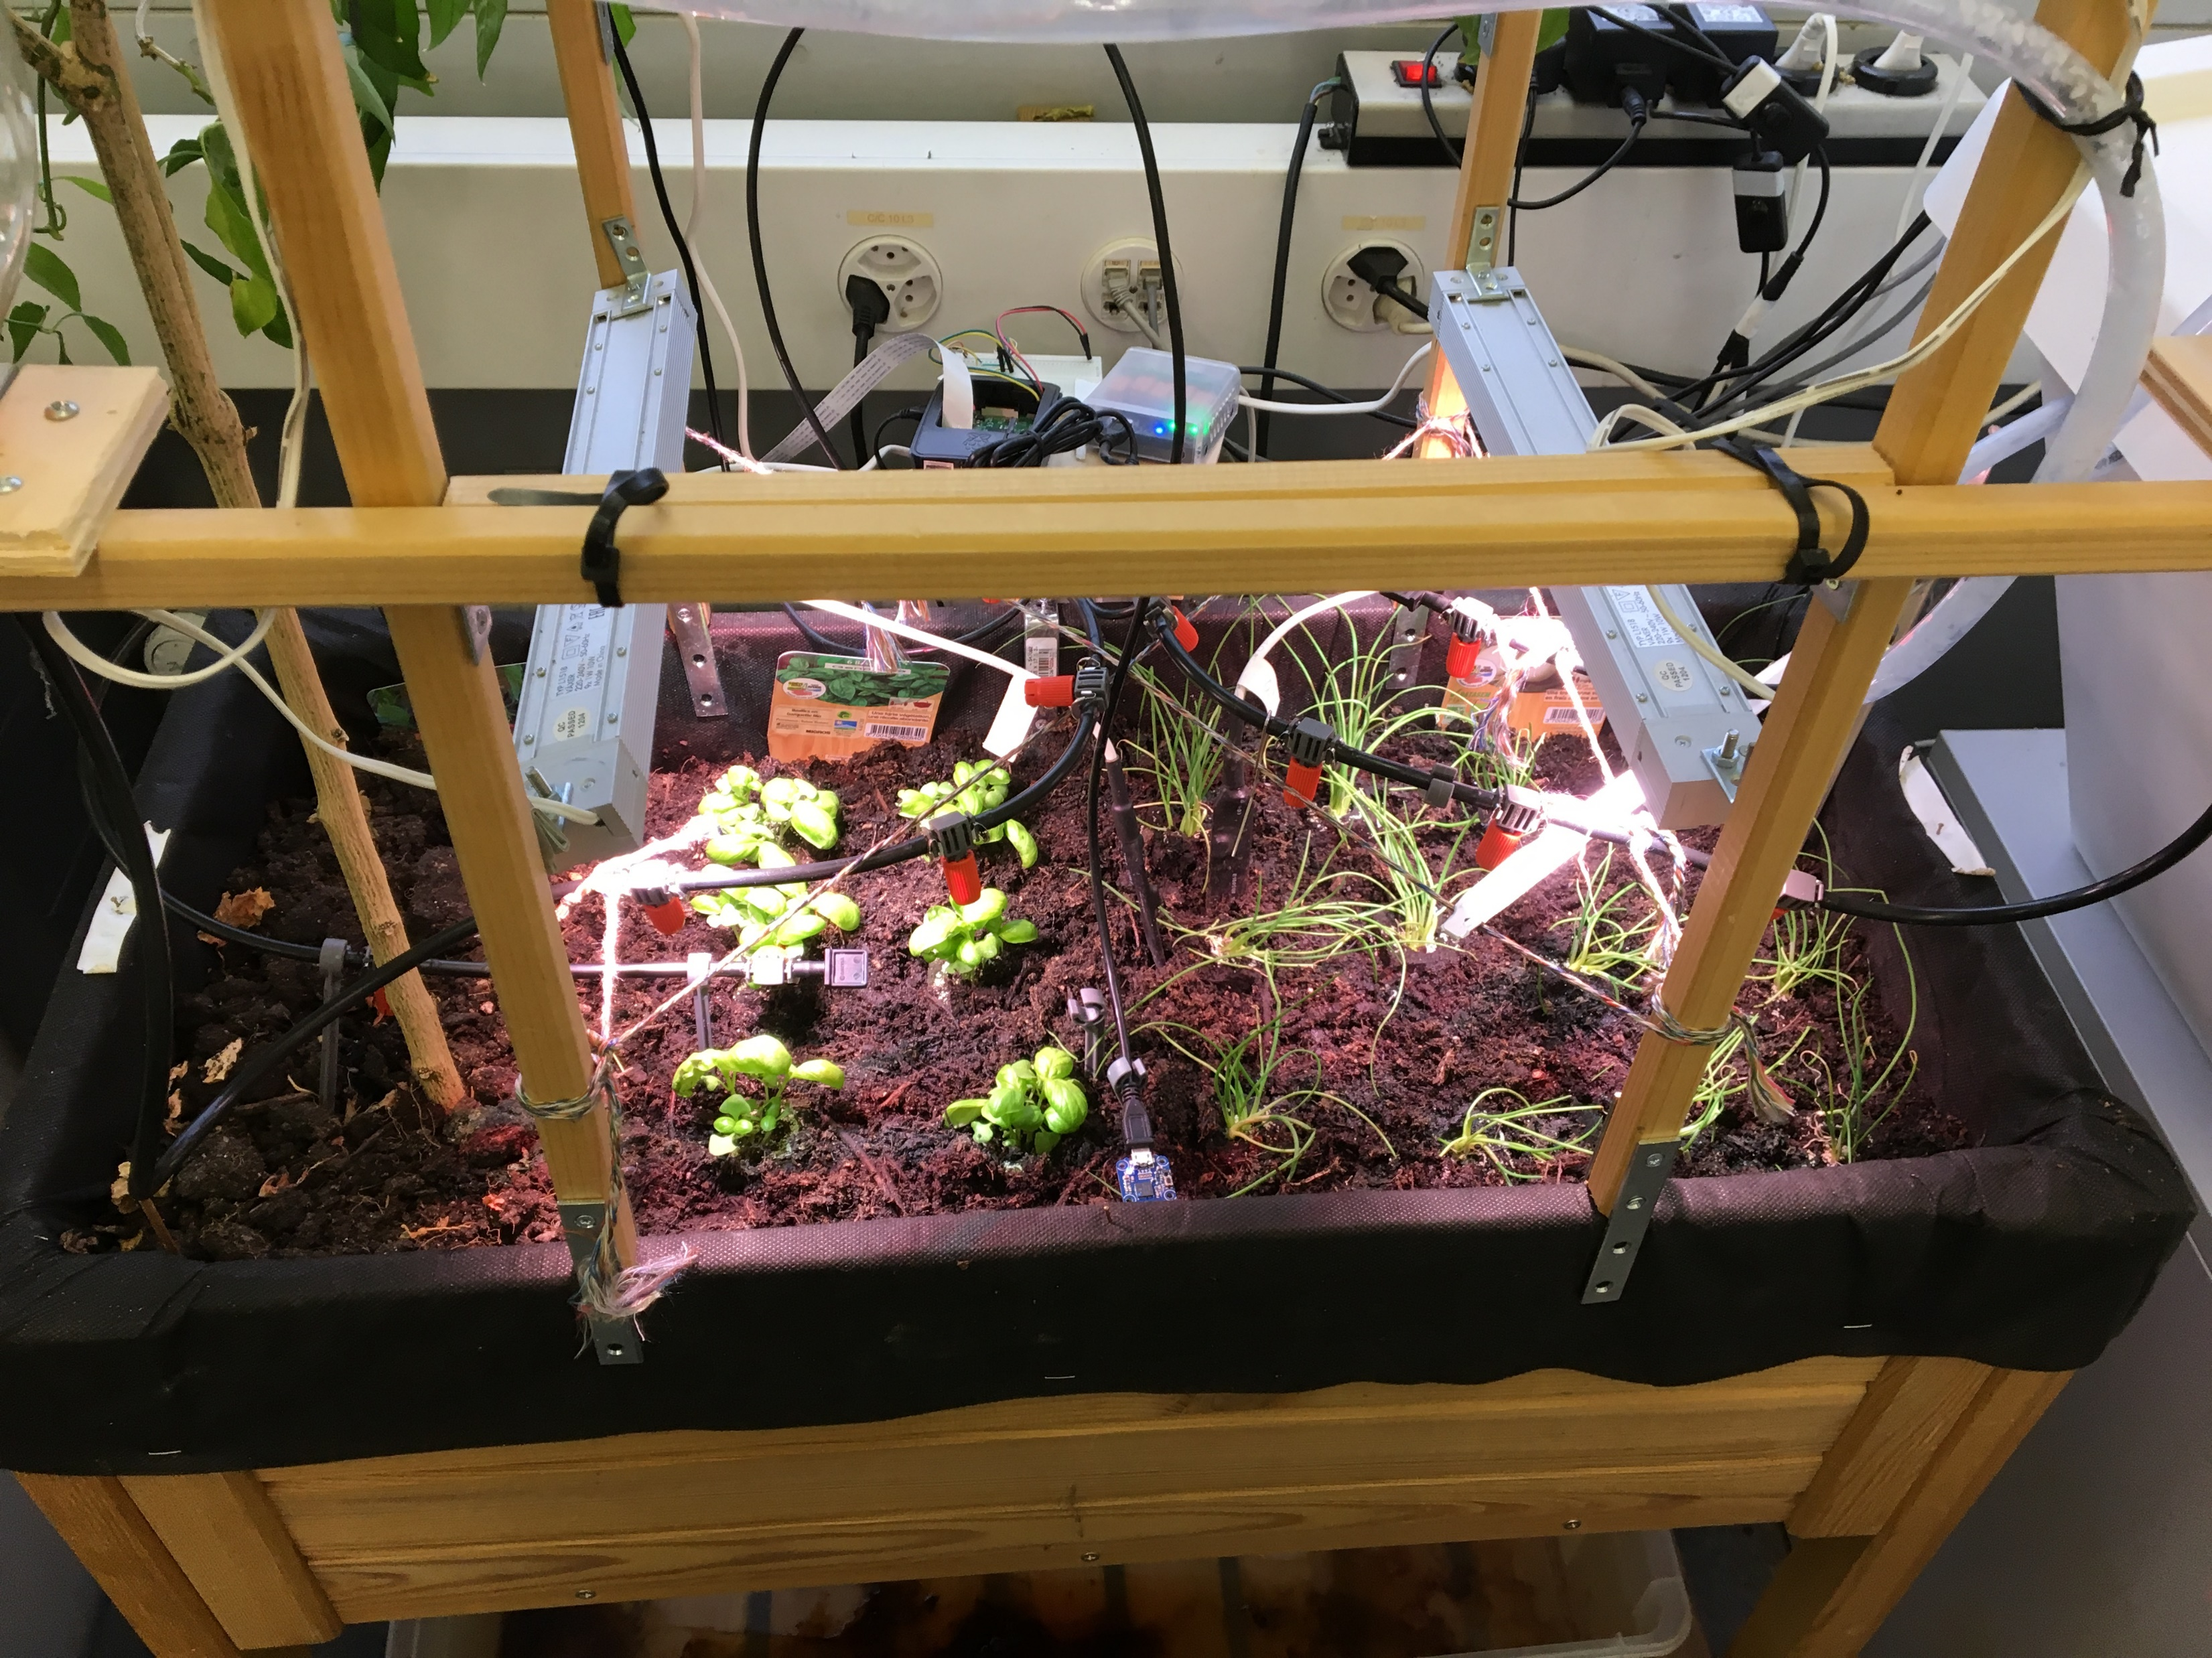
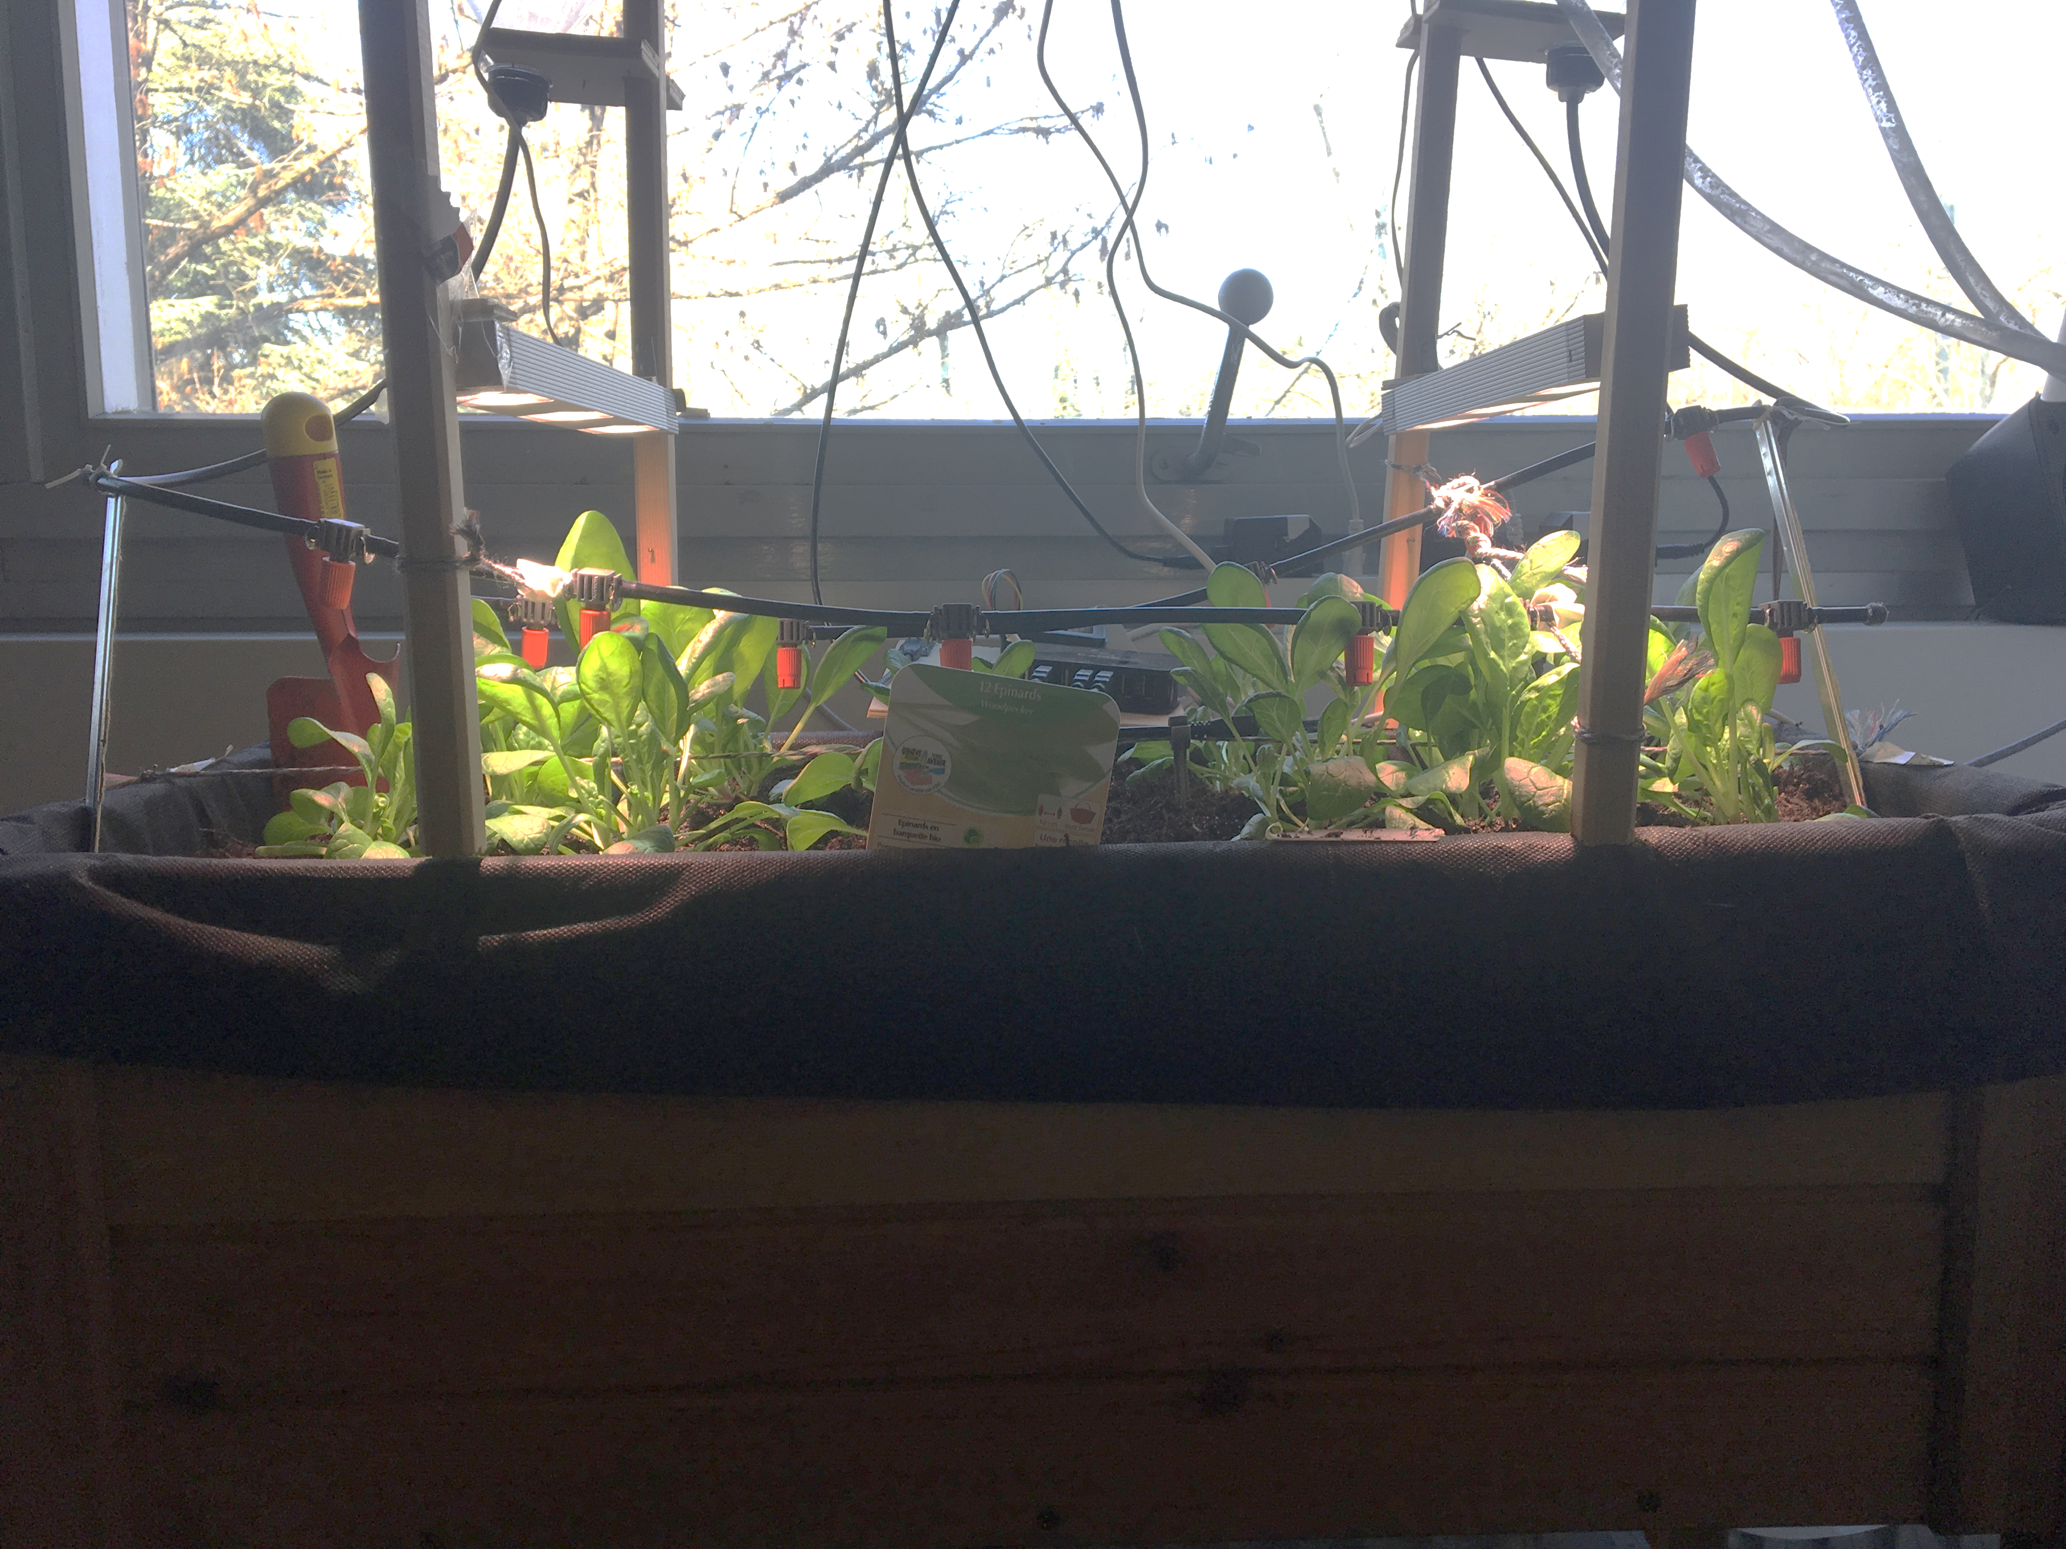
Planting
Basilic, onion, spinach

Slide 6
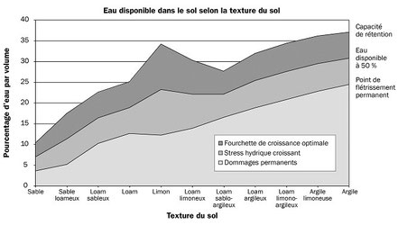
Optimal soil Moisture depending of the soil
Source : https://www.capteurs-et-mesures-agralis.com/mesure-humidite-sol/

Slide 7






Slide 8


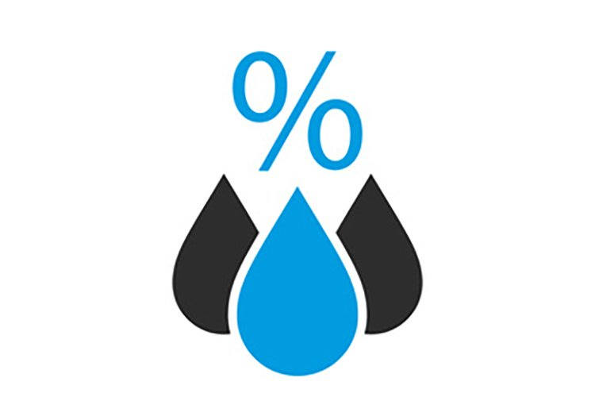
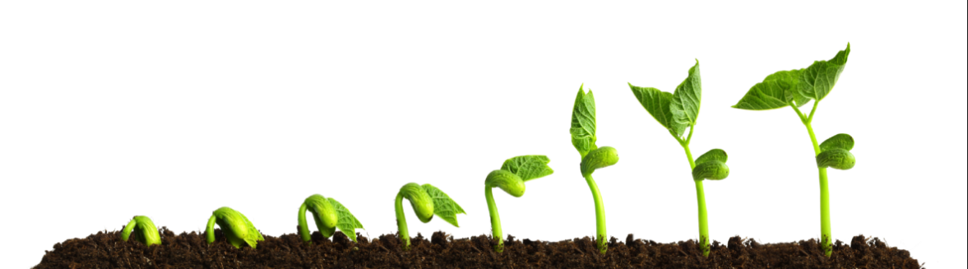

Slide 9
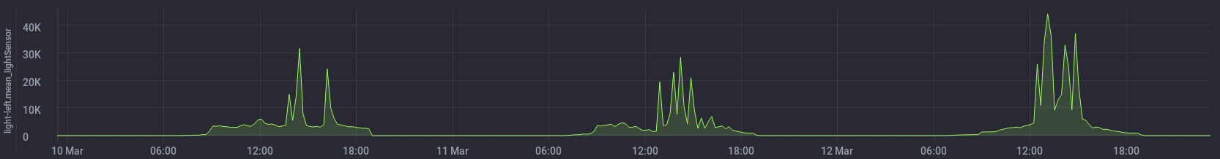
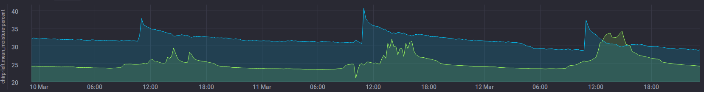
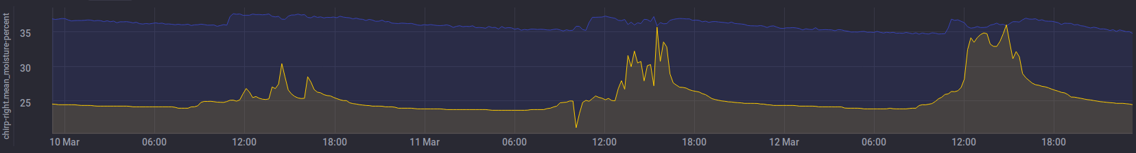
Result Analyse
Demeter.autogen chirp-left : Moisture percent and temperature
Demeter.autogen chirp-right : Moisture percent and temperature

Slide 10

Encountered problem
Position of the humidity sensor
Weird curve
Not found comparable experience in indoor small scale

Slide 11
Planning for the next 3 weeks
End of the research of Literature
Research about Machine Learning algorithm
Implementation of a first easy ML algorithm
Bayesian learning machine approach for Regression
Least Squares Multiple Linear Regression
Vary the watering with respect of the plants

Slide 12
Project Planning

Slide 13
Date | Ceres | Demeter | Autre
6-Mar | 10 s/j | 10 s/j
13-Mar | 10 s/j | 10 s/j
20-Mar | 10 s/j | 10 s/j
27-Mar | 20 s/j | 15 s/j
3-Apr | 20 s/j | 15 s/j | Full watering
10-Apr | 50 s/2j | 30 s/2j
17-Apr | 30 s/j | 10 s/j
24-Apr | 30 s/j | 10 s/j
1-May | 40 s/j | 20 s/2j | Full watering
8-May | 20 s/0.5j | 20 s/j
15-May
22-May |  |  | Full watering
29-May
5-Jun |  |  | Full watering
12-Jun
19-Jun |  |  | Full watering
26-Jun
3-Jul
10-Jul
Watering Plan

